Slide 1
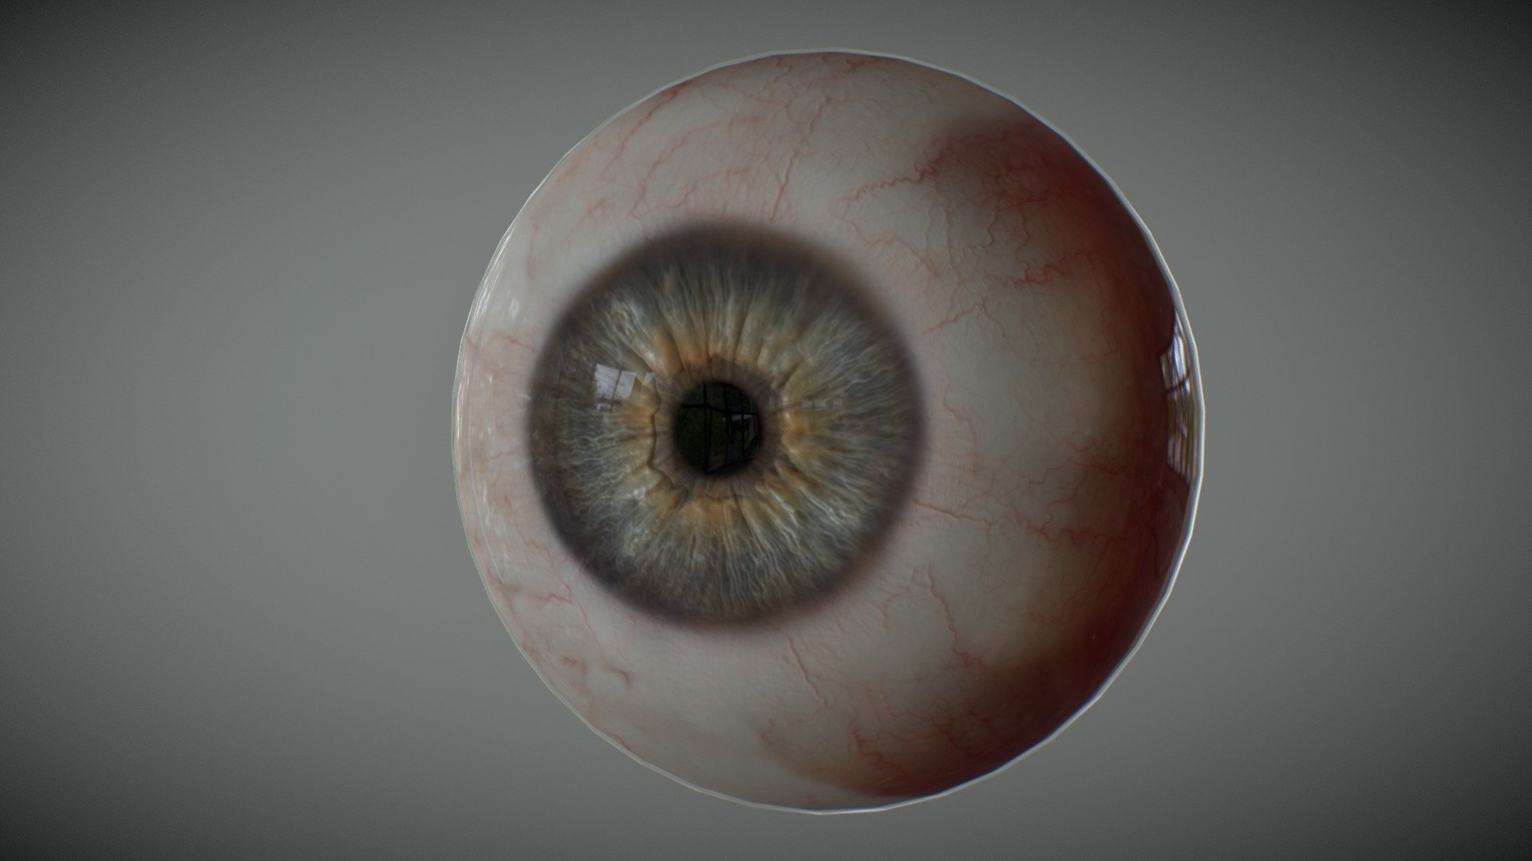
Sense Organs
Eye
This Photo by Unknown Author is licensed under CC BY

Slide 2
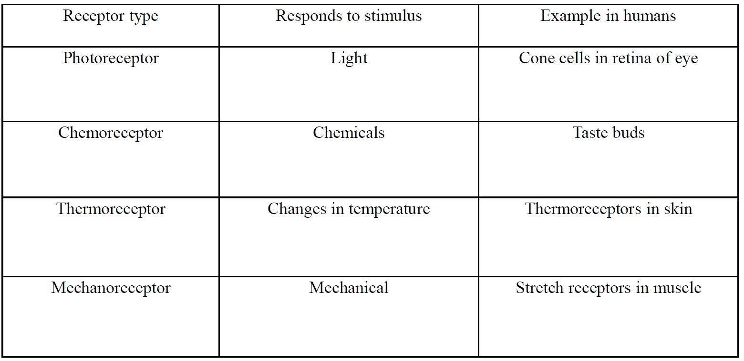
Stimulus: is anything that affects living organisms and let it produces a reaction.
Receptors: structures, which detect stimuli.
Receptors can be classified according to the type of stimulus they respond to, as shown in the table

Slide 3
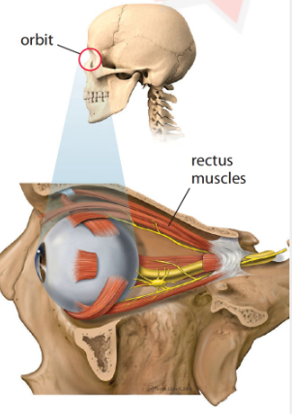
Human Eye
The eye is the sense organ responsible for sight
It lies in a hollow in the skull called the orbit
Each eyeball is attached to the skull by rectus muscle

Slide 4
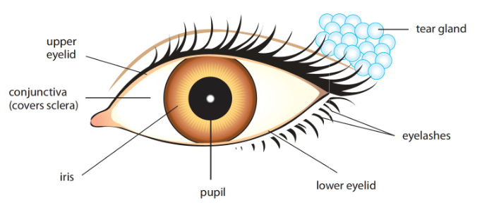
Structure of the eye

Slide 5
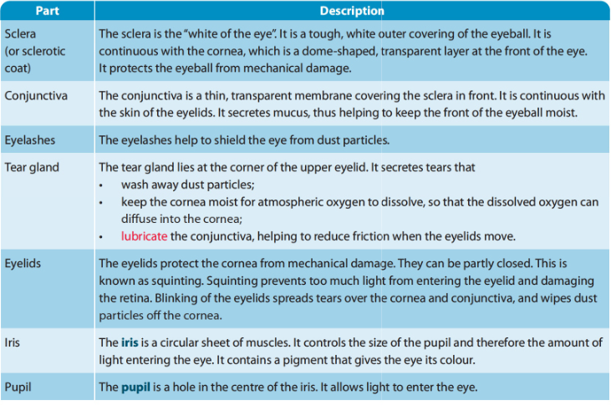

Slide 6
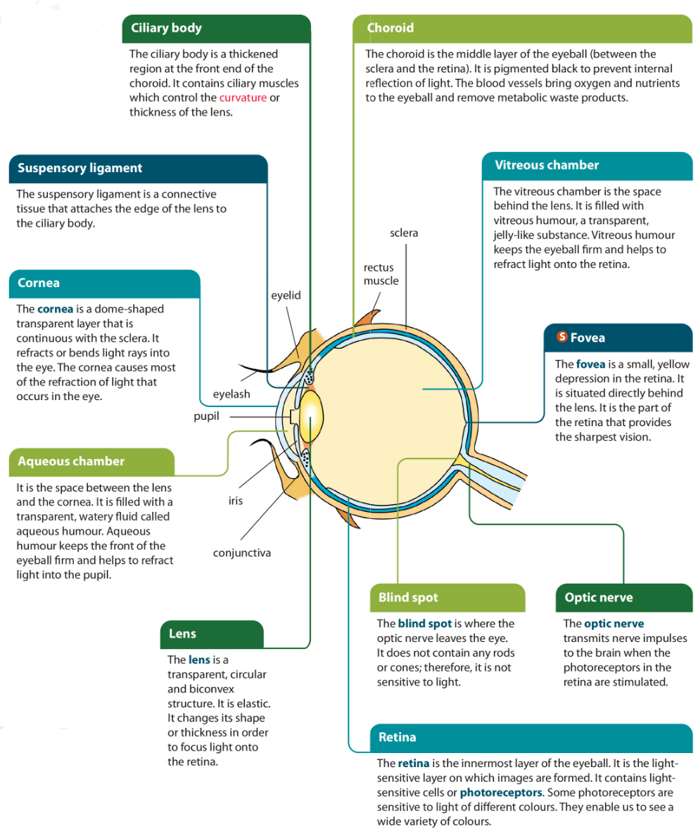

Slide 7
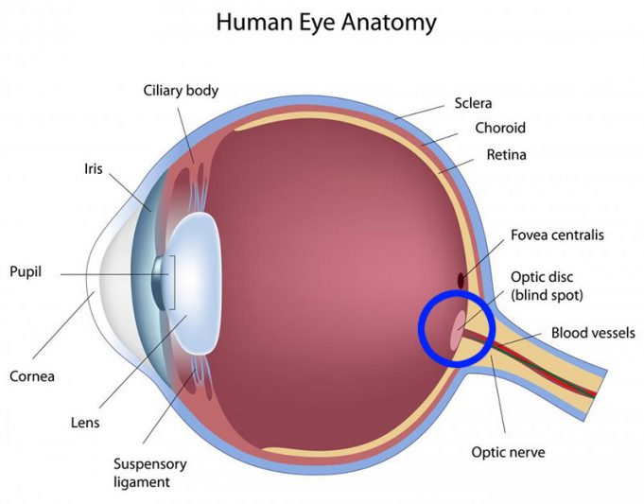
Blind Spot
The blind spot is the point where the optic nerve leaves the retina, there are no sensory cells and no information reaches the brain about that part of the image, which falls on the blinds spot.
https://www.youtube.com/watch?v=XPquOR8-j_E

Slide 8
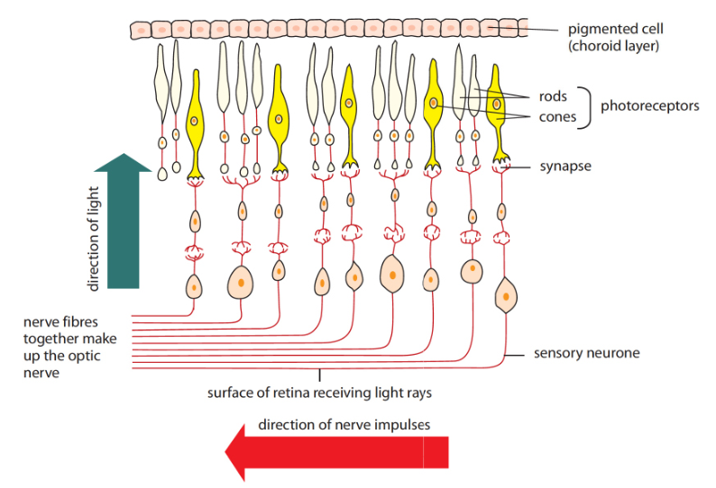
Photoreceptors in the Retina

Slide 9
Photoreceptors in the Retina
Rods
are packed most tightly around the edge of the retina.
Rods provide black and white images with no details.
Rods are sensitive to light of low intensity because they contain a pigment called visual purple(rhodopsin)
When eye is exposed to bright light, all visual purple are bleached, and they need to form again for a person to seen in dim light
The formation of visual purple requires Vit. A
A person who lacks Vit A suffers from night blindness

Slide 10
Photoreceptors in Retina
Cones
Enable us to see colours or details. Cones only work under high light intensity.
Cone cells are packed most tightly at the center of the retina. Objects are seen most clearly during daylight by looking directly at them.
We have 3 types of cones:
• Cones respond to red light.
• Cones respond to green light.
• Cones respond to blue light.
• If all three types are equally stimulated we get the sensation of white.
• Color differences depend on light wavelength .

Slide 11
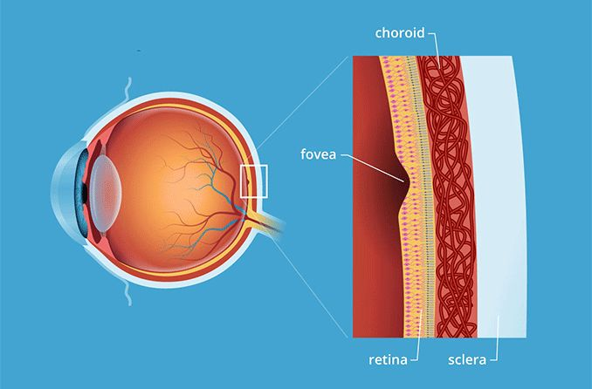
Fovea
is the most sensitive region in the retina.
It contains only cones.
When you examine an object closely you are making its image to fall on the fovea.

Slide 12
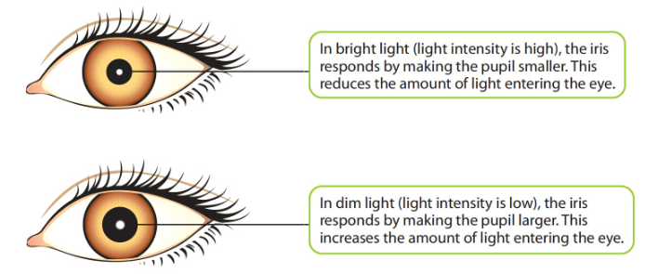
Pupil Reflex
Sometimes, the light may be so bright that decreasing the size of the pupil is not enough.
The eye lids become closer to each other, to screen off part of the light.
This prevents excessive light from entering the eye and damaging the retina.

Slide 13
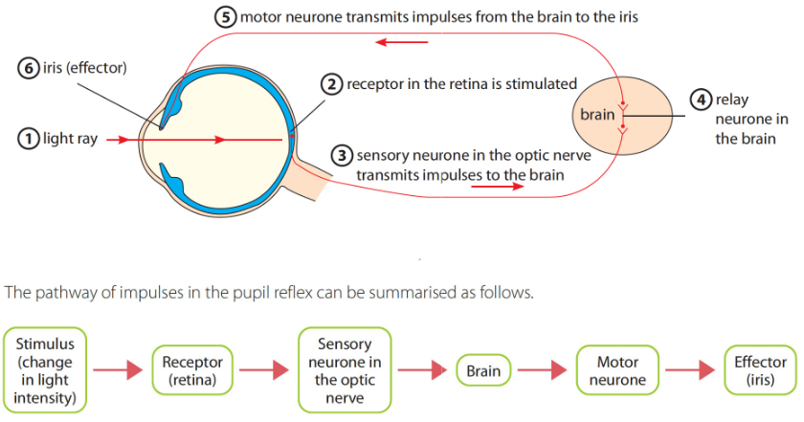

Slide 14
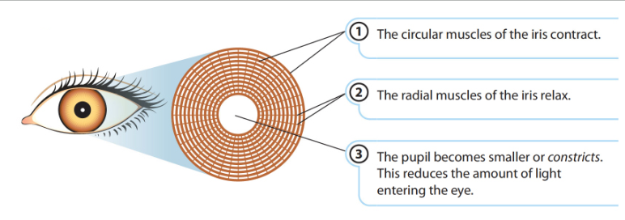
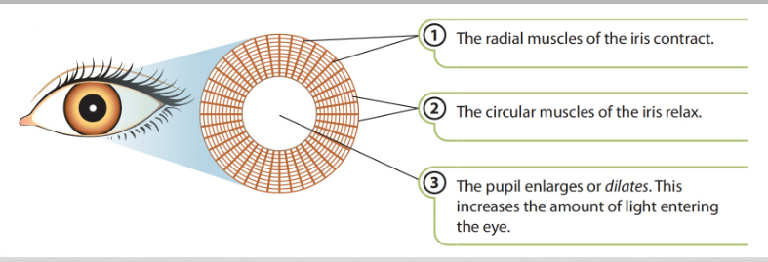
How Iris controls the amount of light entering the eye
Bright light
Dim light

Slide 15
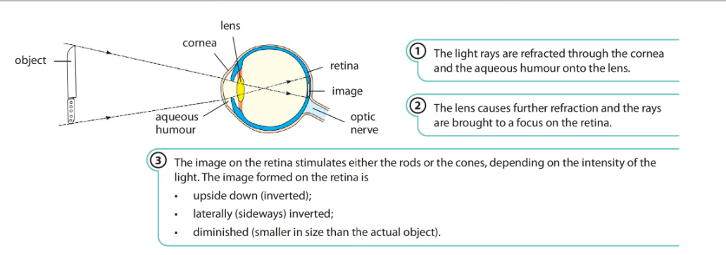
How do we see?

Slide 16
Focusing/Accommodation
Is the adjustment of the lens of the eye, so that clear images of the objects are formed at the retina.

Slide 17
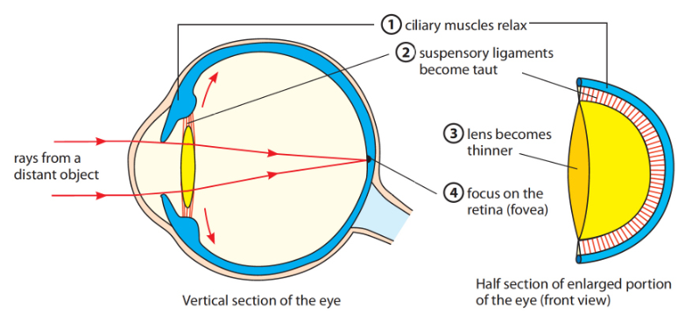
Accommodation for distant objects
Light from distant object.
• Ciliary muscle relaxes.
• Vitreous humour presses on the sclera.
• Suspensory ligaments tight(taut).
• Lens pulled thin and less convex, increasing its focal length
• Result: Light is focused on retina (fovea) and a clear image(details)of an object is formed

Slide 18
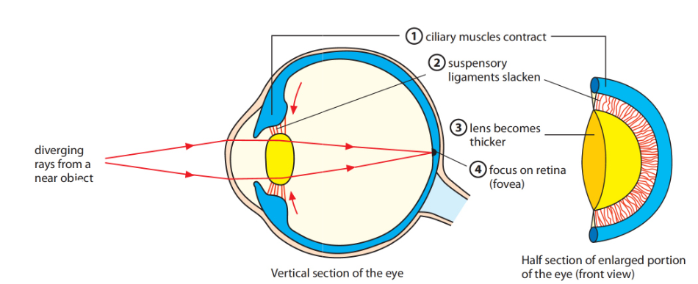
Focusing on Near objects
• Light from near by object.
• Ciliary muscles contract.
• Suspensory ligaments slacken, relaxing their pull on the lens.
• Lens gets thicker and more convex, decreasing its focal length.
• Result: Light is focused on retina (fovea)

Slide 19
Three D vision
combining two images
Having two eyes (binocular vision) is better than having one eye for the following reasons:
it gives a larger field of vision.
- a defect in one eye does not result in blindness.
- in animals with two forward-facing eyes, it provides the potential for 3D vision.
Three D vision depends on each eye being able to look at the same object from a slightly different perspective. The visual center in the brain combines the two views to make a three-dimensional image.
Stereoscopic vision provides information about the size and shapes of objects enable distances to be judged accurately.

